Slide 1
Python DTS PRoA 2022 Introduction to Object-Oriented Programming
Muhammad Ogin Hasanuddin
KK Teknik Komputer
Sekolah Teknik Elektro dan Informatika
Institut Teknologi Bandung

Slide 2
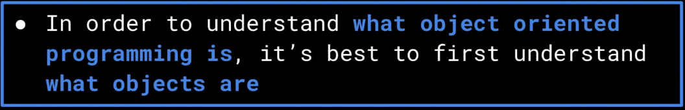
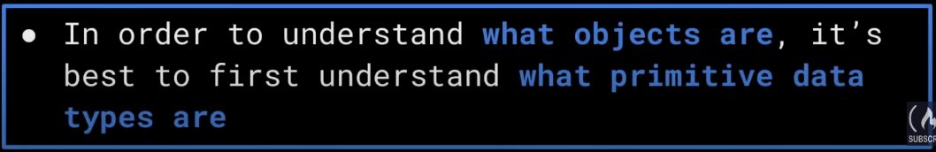
Why Primitive Data Type Isn’t Enough

Slide 3
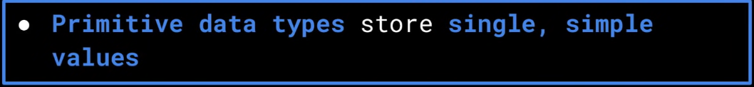
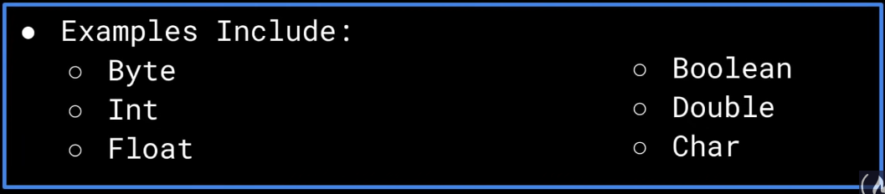
What is Primitive Data Type?

Slide 4
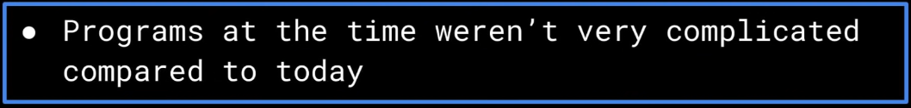
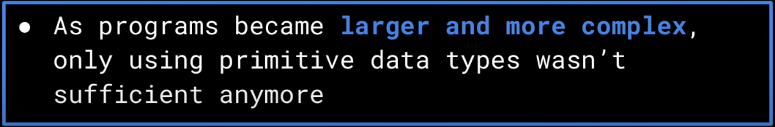
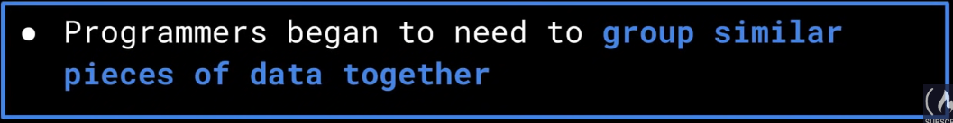
Primitive Data Type

Slide 5



Example
Position
Captured
Colour

Slide 6


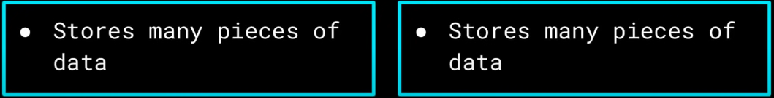
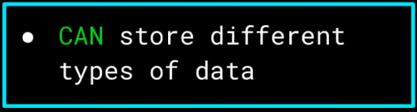
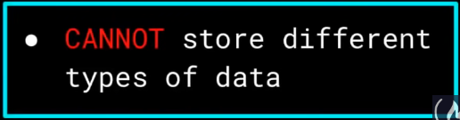
Can We use Structure? Or Array?

Slide 7
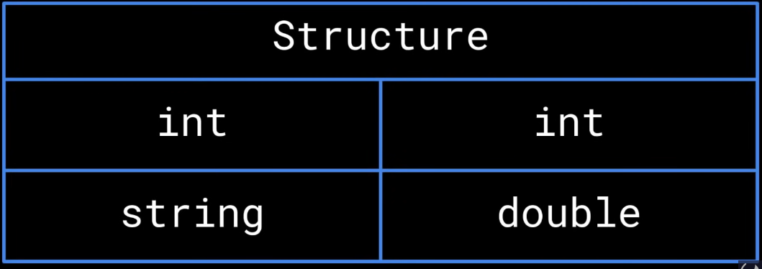
Can We use Structure?

Slide 8
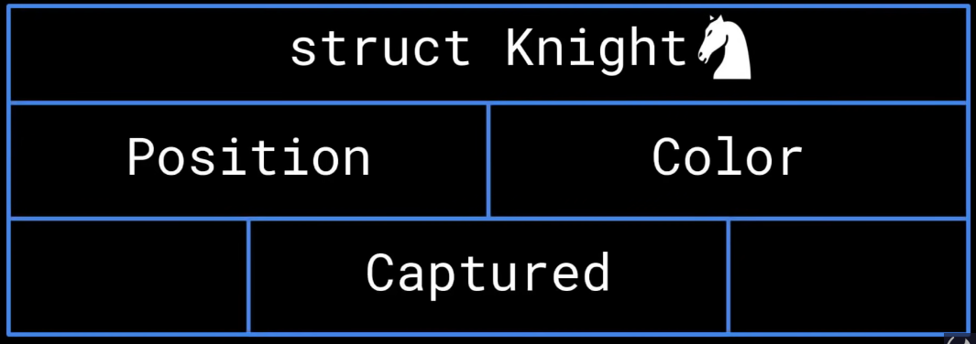
Can We use Structure?

Slide 9
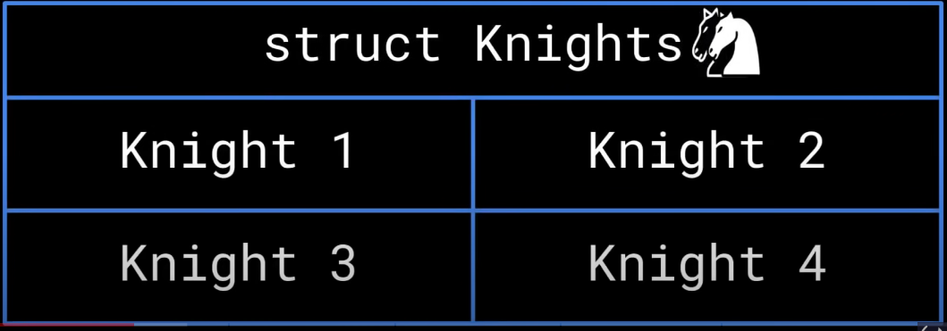
Can We use Structure?

Slide 10
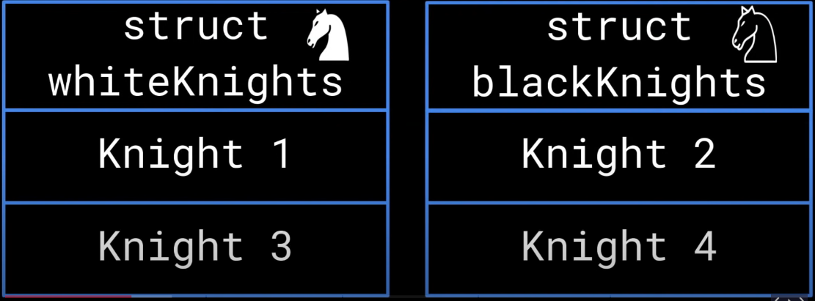
Can We use Structure?

Slide 11
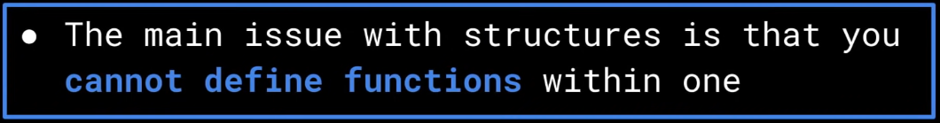
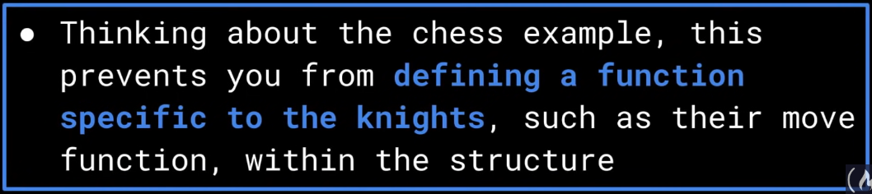
Can We use Structure?

Slide 12
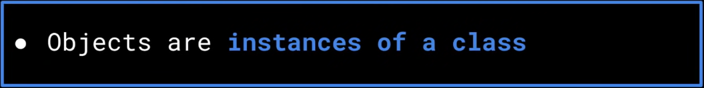

What are Objects?
Circular Explanation?

Slide 13
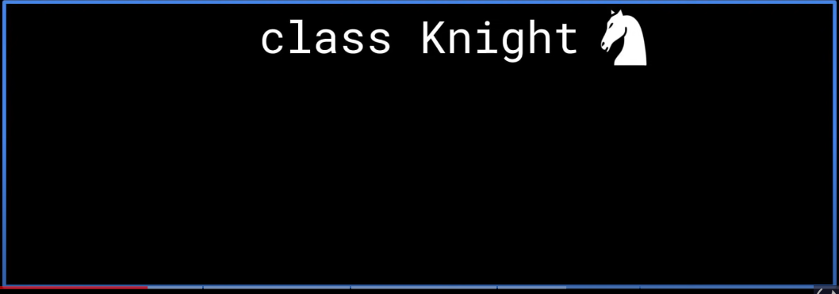
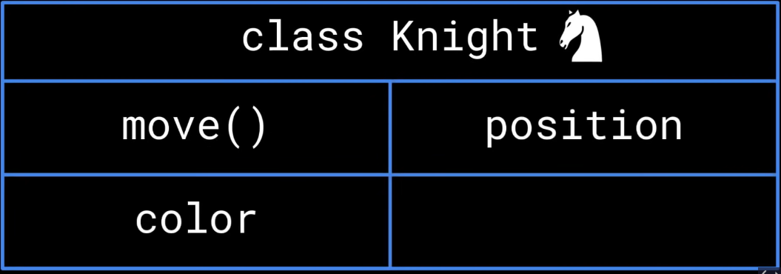

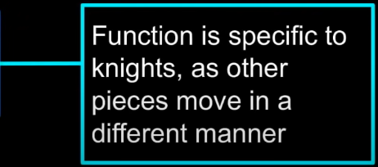
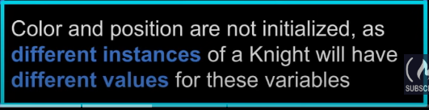
Class Attributes/Methods VS Instance Attributes/Methods Conundrum
Classes and Objects

Slide 14
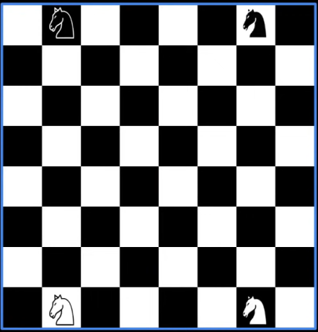
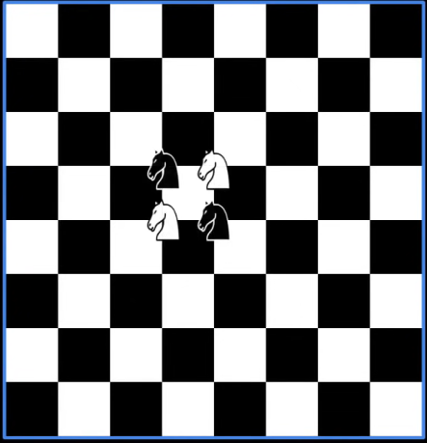
Class vs Instance Attributes/Methods
Initialize Position From Inside the Class
Position: Instance Attributes

Slide 15
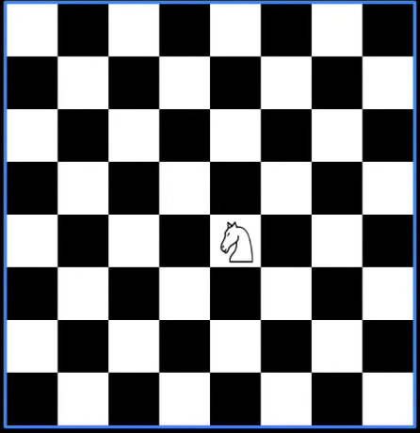
Class vs Instance Attributes/Methods
Move(): Class Methods

Slide 16
Unified Modelling Language Representation

Slide 17
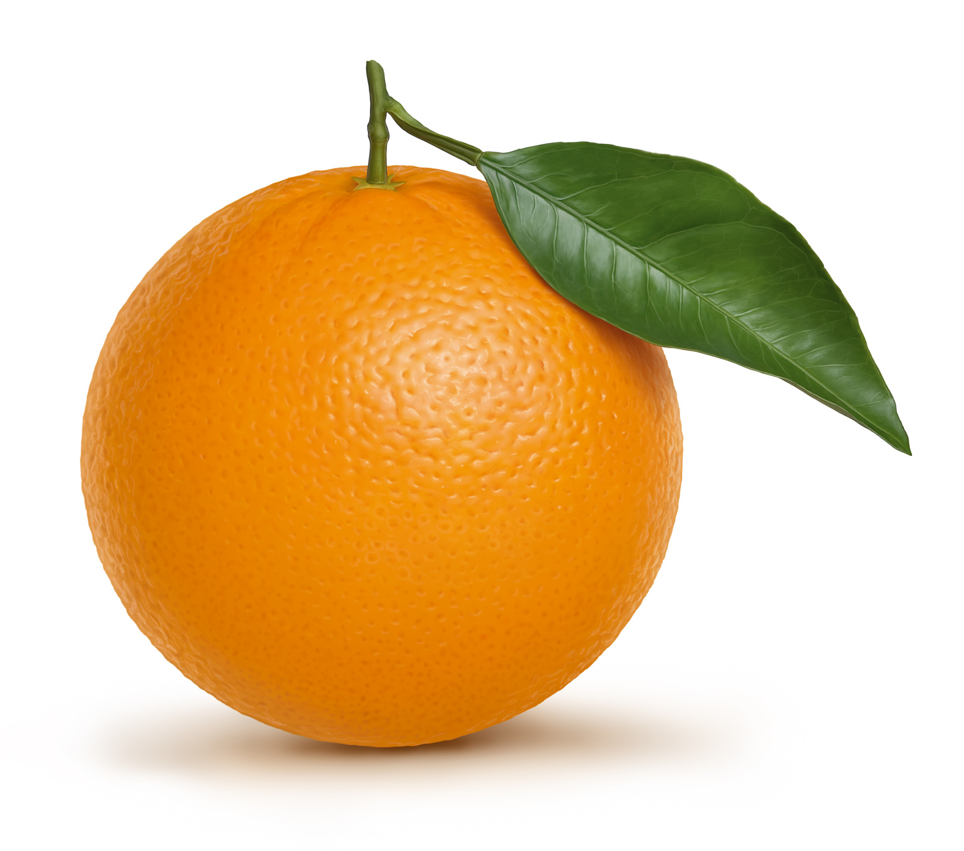
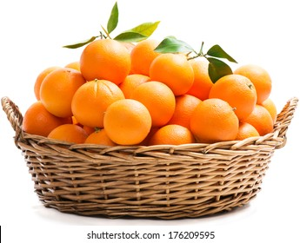
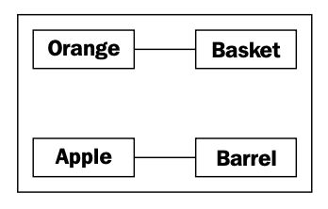
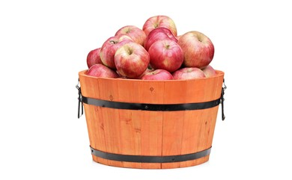
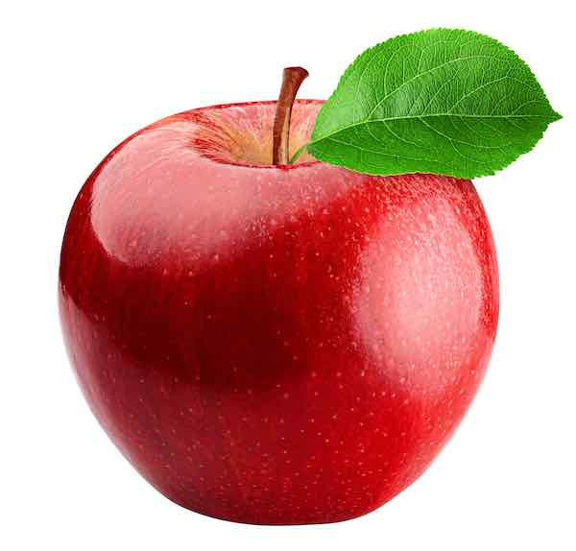
Classes and Objects in Unified Modelling Language

Slide 18
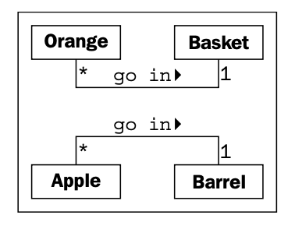
Classes and Objects in Unified Modelling Language
The beauty of UML is that most things are optional
We only need to specify as much information in a diagram as makes sense for the current situation
class diagram
Many Apples go in one Barrel
One Basket can hold many (represented by a *) Orange objects
Any one Orange can go in exactly one Basket

Slide 19
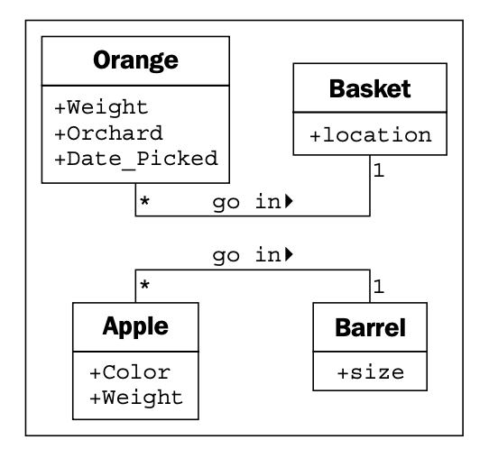
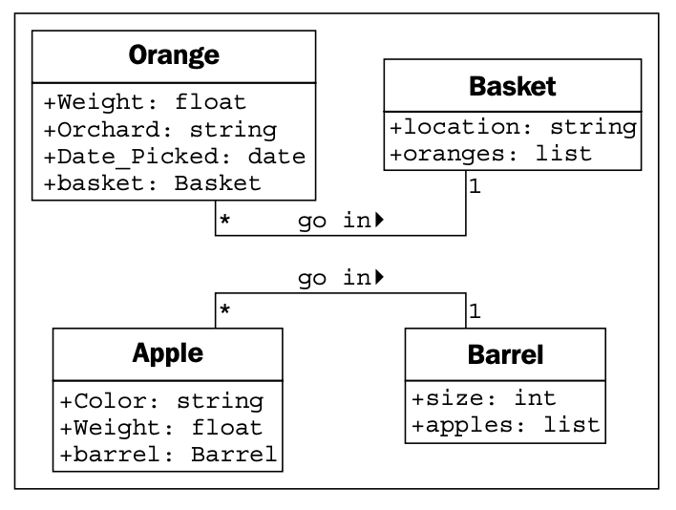
Classes and Objects in Unified Modelling Language

Slide 20
Four Main Principles of OOP
Encapsulation
Abstraction
Inheritance
Polymorphism

Slide 21
First Principle: Encapsulation

Slide 22
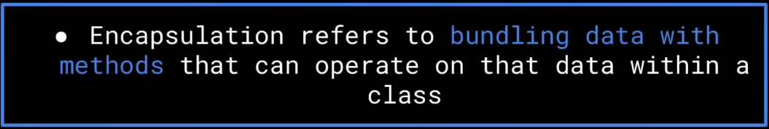
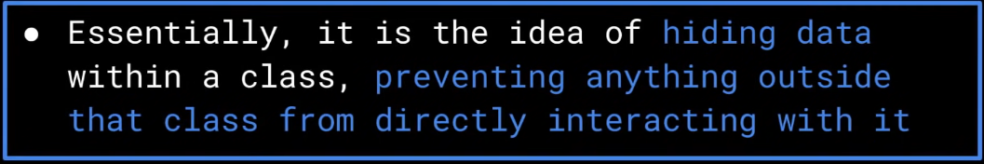
Encapsulation

Slide 23
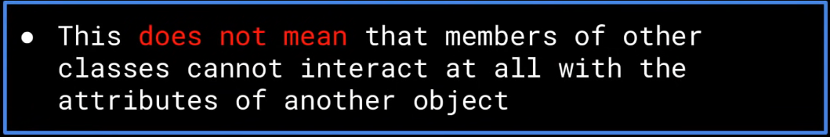
Encapsulation

Slide 24
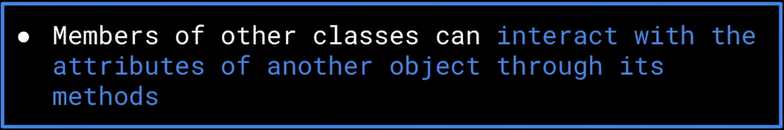
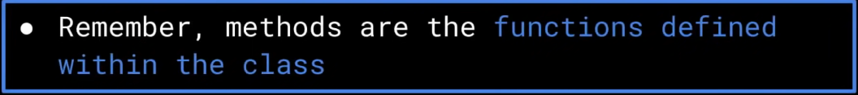
Encapsulation

Slide 25
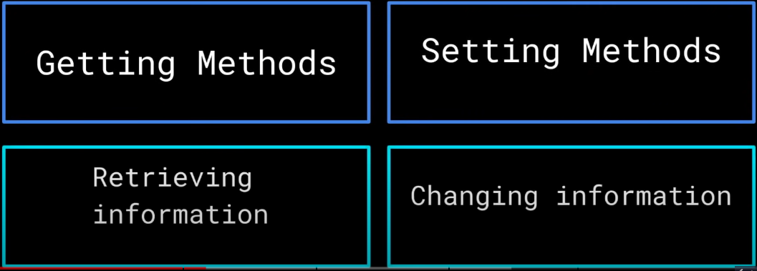
Encapsulation using Getter and Setter Methods

Slide 26
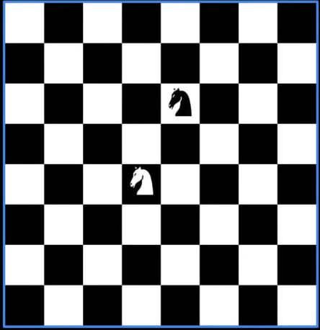
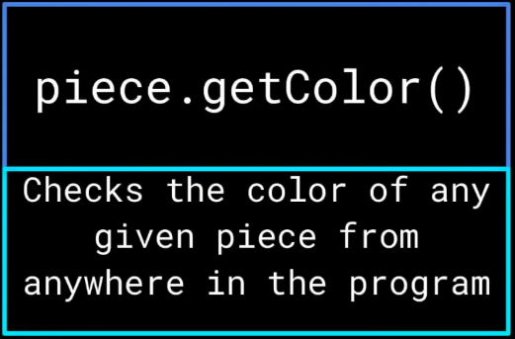
Encapsulation: Chess Example

Slide 27
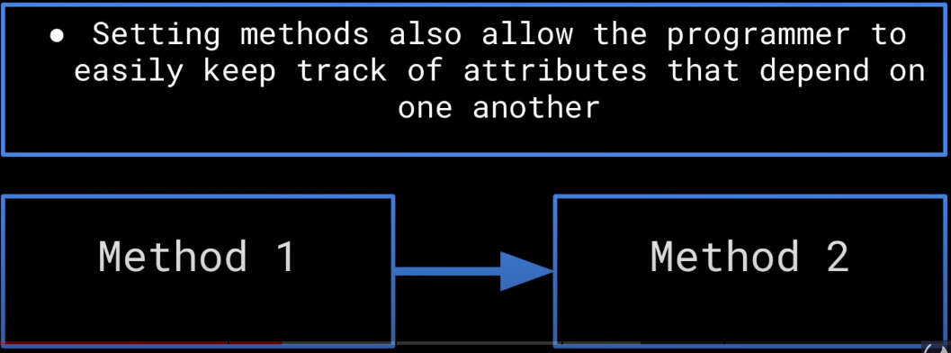
Encapsulation: Tracking Attributes

Slide 28


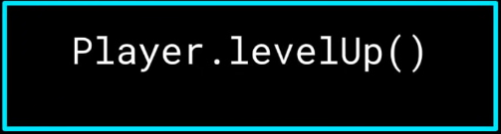


Encapsulation Example: Game

Slide 29
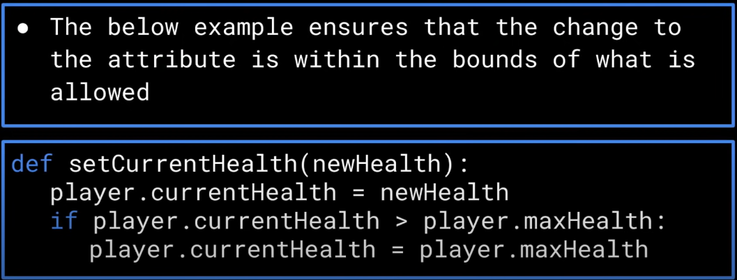
Encapsulation: Validation using Setter Method

Slide 30
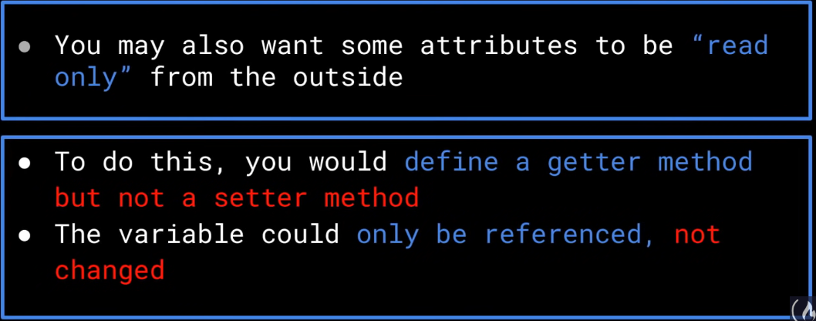
Encapsulation: Read only Attributes

Slide 31
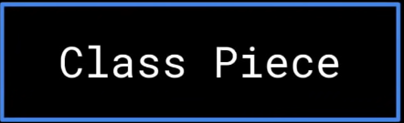
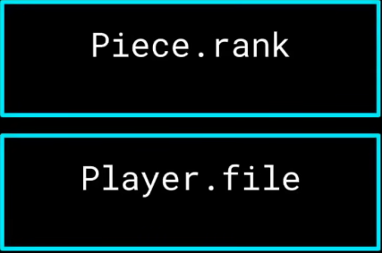
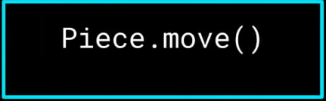
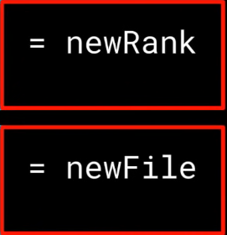
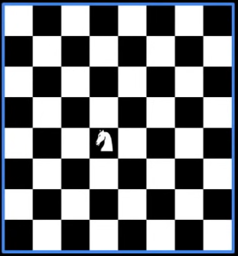
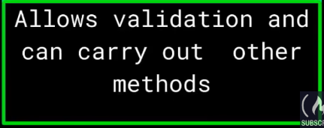
Encapsulation: Chess Example

Slide 32

Encapsulation- Chess Example
If each piece can change its rank and file attributes directly, we may end up in invalid position such as:
Getter Methods that allows validation is very useful

Slide 33



Encapsulation: Information Hiding

Slide 34

Encapsulation: Information Hiding

Slide 35

Encapsulation: Overview

Slide 36
Second Principle: Abstraction

Slide 37




Abstraction: Car Example

Slide 38



Abstraction: Car Example

Slide 39


Abstraction in OOP

Slide 40


Abstraction in OOP

Slide 41


Abstraction in OOP

Slide 42


Abstraction in OOP

Slide 43


Abstraction: Interface and Implementation

Slide 44




Abstraction: Interface and Implementation

Slide 45






Abstraction: Chess Example

Slide 46


Abstraction: Independence Against How Other class is defined

Slide 47

Abstraction: Interface and Implementation

Slide 48


Abstraction: Overview

Slide 49
Third Principle: Inheritance

Slide 50

Inheritance: Introduction

Slide 51



Inheritance: Game Example

Slide 52




Inheritance: Game Example

Slide 53


Inheritance: Class Hierarchy

Slide 54

Inheritance: Class Hierarchy

Slide 55


Inheritance: Access Modifier

Slide 56

Access Modifier: Public

Slide 57


Public Access Modifier: Example
Let’s say public attributes/methods are declared here

Slide 58


Access Modifier: Private

Slide 59

Private Access Modifier: Example
Let’s say private attributes/methods are declared here

Slide 60


Access Modifier: Protected

Slide 61

Protected Access Modifier: Example
Let’s say protected attributes/methods are declared here

Slide 62
Fourth Principle: Polymorphism

Slide 63

Polymorphism: Introduction

Slide 64


Dynamic Polymorphism

Slide 65


Dynamic Polymorphism

Slide 66



Dynamic Polymorphism: Car Example

Slide 67



Dynamic Polymorphism: Car Example

Slide 68

Dynamic Polymorphism: Car Example

Slide 69

Dynamic Polymorphism: Car Example

Slide 70


Dynamic Polymorphism

Slide 71


Static Polymorphism

Slide 72

Static Polymorphism

Slide 73

Static Polymorphism

Slide 74







Static Polymorphism: Car Example

Slide 75


Static Polymorphism

Slide 76


Static Polymorphism: Overview

Slide 77
Terimakasih!

